Slide 1

MedVoyage
GroupName: Squad8

Slide 2
Team Members:
Emmie Abels
Kalyan Cheerla
Vidhi Bhatt
Yasmeen Haleem
Bhavani Rachakatla
Demir Altay
Manushree Buyya
Pravallika Bollavaram

Slide 3
Project Description
Have you ever felt low and absolutely could not find the motivation to pick up the phone and go through the long and tedious process of contacting your doctor? Even if you pick up the phone, you are often left on voicemail. Not only does this waste your time and energy, it also does not provide efficient or practical results. Now you are wondering what if you could easily and quickly book a doctor’s appointment that assists you with your concerns?
MedVoyage !!!

Slide 4
Project Concept
The system we plan to develop is a booking system for a clinic.
Our booking system will be designed for use by both patients and doctors.
When patients use the system, they will be able to :
book an appointment with any doctor
show the patients what appointments are available for each doctor .
doctors will be able to set their schedules.
Doctors will also be able to see their entire schedule for any day, week, or month at any time and will be able to easily pull up the patient information.

Slide 5
Languages and Technologies
Front-End:
We are planning to use HTML, CSS, Bootstrap and some JavaScript as frontend by extending the templates in Django/Flask, and the full-fledged web-framework like Django comes with many libraries that can be used to enhance our web application to be the best possible version of itself and more mobile friendly.
Django’s high-level abstractions, security features, and admin interface can accelerate development and ensure robustness in managing sensitive healthcare data.
Back-End:
For the hosting we are planning to use GCP (Google Cloud Platform) and for the backend programming language we will use Python with backend frameworks like Django/Flask. Below we will go more into depth about what GCP and Python are and their benefits for this project.
Google Cloud Platform is a comprehensive cloud computing platform provided by google that offers a wide array of cloud services, including computing, storage, databases, machine learning and more.

Slide 6
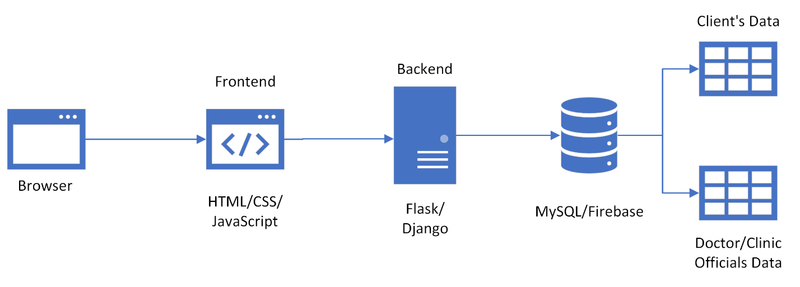
Languages and Technologies

Slide 7
Platform
For our project, we have decided to create a webapp that is mobile friendly.
We felt that MedVoyage should be easily accessible from any device so patients are able to book an appointment wherever they are.
The webapp will focus on being mobile friendly since many people often use their phones or tablets to book appointments.
When a person is sick, the last thing they want to do is hassle with making an appointment on a computer so making the webapp mobile friendly allows for a better user experience for patients.
Many clinics often use tablets with doctors and patients due to how portable they are and because they are easy to clean.
A mobile friendly web app ensures that any clinic and doctor can see their patient's information and schedule throughout the day with ease.

Slide 8
Development Environments
As a development environment, we will use
Visual Studio Code - is a free open-source editor designed by Microsoft and it is a light weighted and extensible design that makes it a popular choice among developers to support various programming languages.
PyCharm - is an integrated development environment (IDE) specifically designed for Python development. It is developed by JetBrains and comes in two editions, Community (free) and Professional (paid).

Slide 9
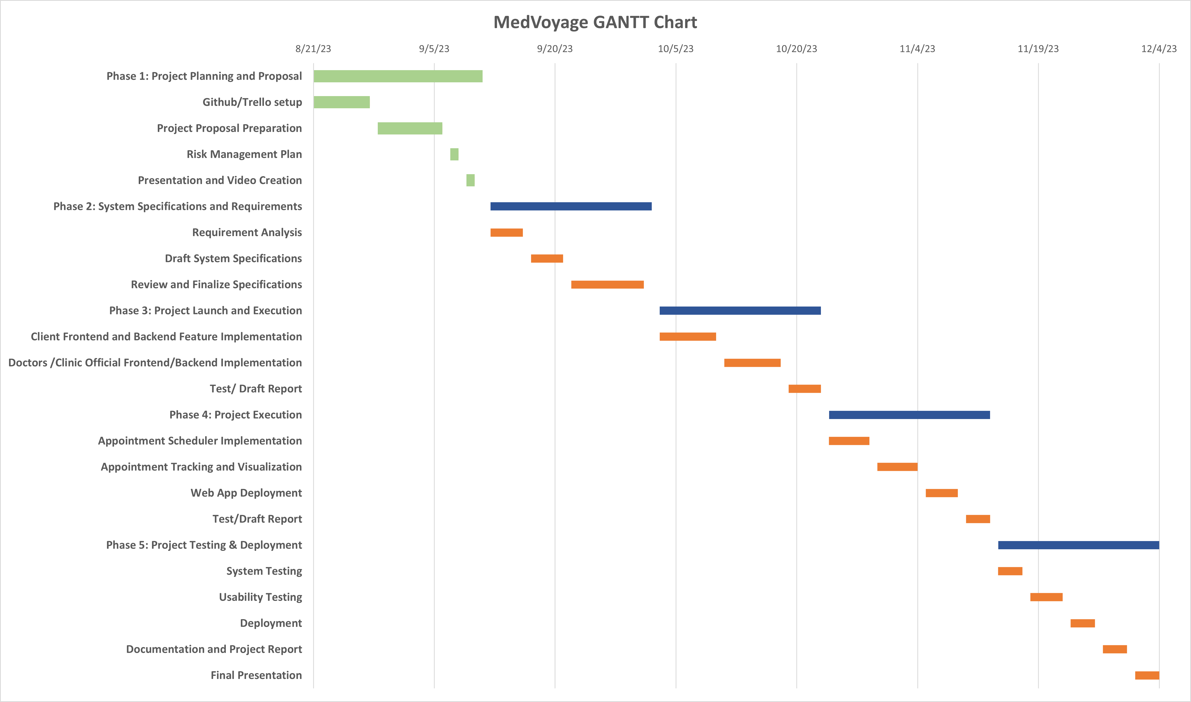
Project Timeline
Completed Tasks
Major Deliverables
Sub Tasks

Slide 10
Risk Management
Top 3 Risks
Privacy: As patients will be booking appointments with the doctors on the medvoyage app, patient’s personal and health information will be uploaded on the webapp. As per HIPAA rule patient’s information is protected by certain guidelines. Care must be taken to prevent unauthorized access to patient data and data breaches.
Resource Access Issues: There can be certain risks associated with cloud resource availability, scalability issues, issues related to server downtime, maintenance or infrastructure failures, issues related to integration with third party services, software bugs.
Data Handling and Password: The data of the customers and the clinic and doctor information should be secured, to prevent accidental data loss or corruption due to human error, hardware failure or software bugs which can lead to data unavailability or integrity issues.

Slide 11
Risk Moinitoring
By identifying the different resource shortages, we can monitor resource access issues.
We plan to monitor privacy or data handling risks by
identifying what type of privacy or data handing issues our program is having once we have the program running
accessing them in a way that our contingency plan and strategies are changing over time.
Apply a type of design that ensures security and privacy.
create an analysis documentation and report risks related to resource shortages, data handling, and privacy concern
Through this analyzation of our risks, we can monitor risk frequency and pay attention to what other than common identifiable risks are possible in our program.

Slide 12
Risk Reevaluation
As certain rules like HIPAA are updated, thus periodically the compliance of the webapp will be reevaluated.
The resources will be updated periodically.

Slide 13
Contingency Plans
The contingency plan regarding the privacy of the patient’s information can be handled by cryptography and encryption and securing the patient’s details in accordance with the HIPAA rules.
To ensure that all the resources like databases and cloud services are running at any given time, and to prevent issues related to resource unavailability, we would like to implement GCP failover.
To ensure safety for data handling and password protection, certain methods like Duo multi factor authentication and encryption of data will be performed.
To prevent payment-related issues dealing with payment cards PCI-DSS compliance standards and rules and regulations will be met.

Slide 14
Team Member Roles
Emmie Abels-Project Management Team, front-end Requirements, Design Lead for the project, Testing.
Kalyan Cheerla- Head of Project Management Team, monitoring team tasks, Handles System administrator/DevOps Engineer and Backend coding tasks.
Vidhi Bhatt-front-end and back-end requirements, documentation, assist in risk management, testing
Yasmeen Haleem-Gantt charts, documentation, presentation, aid in usability testing, services with integration with cloud, web app development and chatbot
Bhavani Rachakatla - I have outlined the tasks and subtasks for the project and have prepared a Gantt chart that encapsulates the entire project plan. Also responsible for Backend development and will also be the Testing Lead for the project.
Demir Altay -back-end requirements ,design lead
Manushree Buyya-back-end web-frameworks, documentation, integration, server and hosting
Pravallika Bollavaram-back-end development, documentation, presentations, and website wireframes, assisting with testing

Slide 15
Thankyou

